Slide 1

Objectives
In this session, you will learn to:
  Identify JavaBeans
  Identify Custom Tags
Notes:
Start the session by sharing the session objectives with the students.

Slide 2
Introducing JavaBeans
A software component is a reusable object that can be plugged into any software application. You can reuse or extend the functionality of a software component on the target application
JavaBeans are software components developed using Java language.
JavaBeans are reusable and self-contained software components, which take advantage of all the security and platform-independent features of Java.
A JavaBean exists in one of the following three phases of development:
  Construction Phase
  Build Phase
  Execution Phase
Notes:
Use this slide to explain about the software components. You can tell that JavaBeans are software components that are developed using Java language. Give some examples, where JavaBeans can be used. In addition, explain the three phases of development of a JavaBean.

Slide 3
Elements of a Java Bean
The elements of the JavaBean components are:
  Properties: Refer to the private data members of a JavaBean that define the behavior of the JavaBeans.
  Methods: Refer to the public member functions of a JavaBean that are used to modify the JavaBean properties.
  Events: Refer to the messages that one JavaBean component sends to another component.
Notes:
Use this slide to explain the elements of a JavaBean.

Slide 4
The JavaBean Component Specification
As per the JavaBean component specification, a Java object must support the following features to become a JavaBean:
  Customization: Is the ability of a JavaBean to allow its properties to be changed during the build and execution phases.
  Persistence: Is the ability of a JavaBean to save its state to a disk or any other storage device when the execution of the container application containing the JavaBean is terminated.
  Communication: Is the ability of a JavaBean to inform changes in its attributes to other JavaBeans and to the container application.
  Introspection: Is the ability of a JavaBean to allow an external application to query the properties, methods, and events supported by it.
Notes:
Use this slide to explain the features of a JavaBean.

Slide 5
Services of JavaBean Component
The JavaBean components provide the following services:
  Builder support: Refers to the Graphical User Interface (GUI) that enables you to create and group various JavaBeans in an application.
  Layout: Allows multiple JavaBean components to be arranged in a development environment.
  Interface publishing: Allows the multiple JavaBean components in an application to communicate with each other with the help of public interfaces.
  Event handling: Refers to the firing and handling of the events associated with the JavaBean components in an application.
  Persistence: Enables you to save the last state of a JavaBean
Notes:
Use this slide to explain the services provided by a JavaBean component.

Slide 6
Types of JavaBean
The JavaBean API provides classes and interfaces that enable you to create three types of JavaBeans.
  Control JavaBeans: Are used to create GUI components that can be plugged into any application.
  Container JavaBeans: Are used to hold other Java Beans.
  Invisible Runtime JavaBeans: Are used to create components that perform a specific task in the background of an application.
Notes:
Use this slide to explain the three types of JavaBeans provided by the JavaBean API.

Slide 7
Identifying Custom Tags
A custom tag is a reusable component defined by the user.
A custom tag enables you to encapsulate the scripting code in the tag handler.
You need to include the custom tag in the JSP page to reuse the Java technology code
Notes:
Use this slide to explain about the custom tags. You can tell that custom tags allows easy reuse of Java code. Due to their ease of use, custom tags can be used by programmers who do not know Java. Explain that JSP technology allows developers to define custom tags, which are markup tags that are replaced by dynamic content when the page is served. The dynamic content is created by a tag handler class, which a programmer creates and packages in a tag library archive file. A programmer defines the syntax for a tag and implements the tag's behavior in the handler class.

Slide 8
Advantages of Using Custom Tags
The advantages of using custom tags are:
  Reduction of scriplets in the code
  Reusability
Notes:
Use this slide to explain the benefits of using custom tags. Explain that Custom tags are reusable, as scripting elements generally are not. In addition to this, libraries of custom tags provide high-level services for JSP pages that are portable across JSP containers. Custom tags are also easy to maintain, because they reduce repeated code. Changing a tag's handler class changes the tag's behavior everywhere it is used. In addition, Custom tags help developers focus on their core skills. Custom tags can decouple business logic and data presentation. This separation eases maintenance, clarifies the intent of each component, and allows programmers and page authors to work relatively independently of one another.

Slide 9
Components of a Tag Library
A custom tag consists of:
  Tag handler: Contains definitions of the classes and methods that define the functionality of the tag
  Tag Library Descriptor (TLD) file: An XML file that describes the tag library
Notes:
Use this slide to explain about the components of a tag library. To define a tag, you need to perform the following tasks:
Develop a tag handler
Define the tag in the TLD.

Slide 10
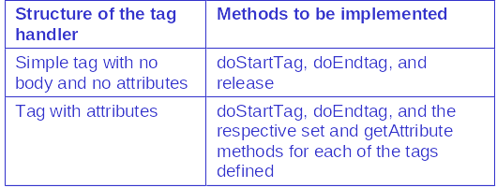
Structure of a Tag Handler
The tag handler is used to define the working of the custom tags
The structure of the tag handler can be categorized as that for a empty tag, a tag with attributes, and a tag with a body.
The methods to be implemented in the tag handler will, therefore, depend upon the structure of the tag, as listed in the following table.
Notes:
Use Slides 10 to 14 to explain about the structure of the tag handler. A tag handler is an object that is invoked by a Web container. It is used to evaluate a custom tag during the execution of the JSP page that references the tag.

Slide 11
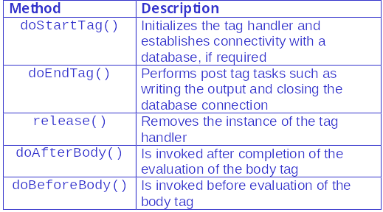
Structure of a Tag Handler (Contd.)
The functionality of the tag library is defined by using the methods from the abstract class Tag.
Some methods of the Tag class are listed in the following table.

Slide 12
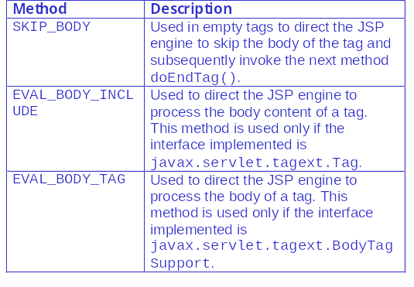
Structure of a Tag Handler (Contd.)
The doStartTag()method, in turn, returns the following tag objects.

Slide 13
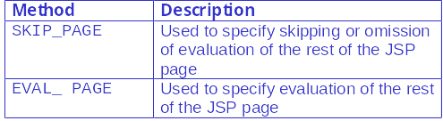
Structure of a Tag Handler (Contd.)
The doEndTag()method returns the following tag objects:

Slide 14
Structure of a Tag Handler (Contd.)
In addition to the methods listed above, the tag handler also includes the following classes and methods:
  JspWriter()
  getAttribute() and setAttribute()
  TagExtraInfo

Slide 15
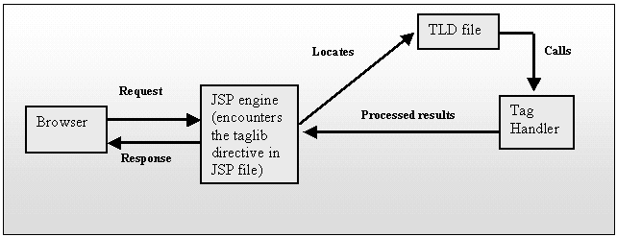
Structure of a Tag Handler (Contd.)
The execution cycle of a JSP file containing custom tags is shown in the following figure.
Notes:
Use this slide to explain how a Web container executes a JSP file containing a custom tags.

Slide 16
TLD File
The TLD file is an XML file that contains the tag library description.
The components of a TLD file can be broadly classified into two groups:
  The first group consists of the elements that are part of the root tag of the TLD or the taglib tag.
  The second group, placed within the taglib tag, consists of the elements that are a part of the tag element.
The taglib tag is written as <taglib> and the tag element as <tag>.
Notes:
Use this slide to explain the TLD file.

Slide 17
Demo: Developing a Custom Tag Application
Larry Williams, the CEO of Techmedia Inc. wants the company to have an interactive Web site, which greets end users who visit the Web site and displays the current time. He also wants the end user to be able to specify the background color of the home page. Larry asks John, the company’s Web master to modify the home page of the Web site so that a customized greeting message is displayed to the end user along with the current system time.
Notes:
Use this slide to demonstrate how to create a custom tag application and use the custom tag in a JSP Page. You can run the project, Greetings stored at Datafiles For Faculty\Session16\Demo1\Greetings.zip file in the TIRM CD.

Slide 18
Demo: Developing a Custom Tag Application (Contd.)
Solution:
  Create the Web Application
  Create an HTML Page
  Create a TLD File
  Create a Tag Handler
  Create a JSP Page
  Access the Custom Tag Application

Slide 19
Summary
In this session, you learned:
  A software component is a reusable object that can be plugged into any software application.
  JavaBeans are software components developed using Java language.
  A JavaBean exists in one of the following three phases of development:
    Construction Phase
    Build Phase
    Execution Phase
  Java object must support the following features to become a JavaBean:
    Customization
    Persistence
    Communication
    Introspection
Notes:
End the session by discussing the summary points as given in Slides 19 to 21.

Slide 20
Summary (Contd.)
  The JavaBean API provides classes and interfaces that enable you to create three types of JavaBeans:
    Control JavaBeans
    Container JavaBeans
    Invisible Runtime JavaBeans
  The custom tags of the tag library provide a mechanism that the programmer can use to encapsulate complex recurring code or tasks.
  A custom tag usage can be specified using the taglib directive.
  Custom tags can be categorized as empty tag, a tag with a body, a tag with attributes.
  The tag handler is used to define the custom tags and derives its methods from the javax.servlet.tagext package and implements the TagSupport or BodyTagSupport interfaces the javax.servlet.

Slide 21
Summary (Contd.)
  The TLD file is an XML file that contains the tag library description.
  The elements of a TLD file at the taglib level are:
    tlibversion
    jspversion
    shortname
    uri
    info
  The elements of the TLD file at the tag level are:
    name
    tagclass
    info
    attribute
    bodycontent

